Slide 1
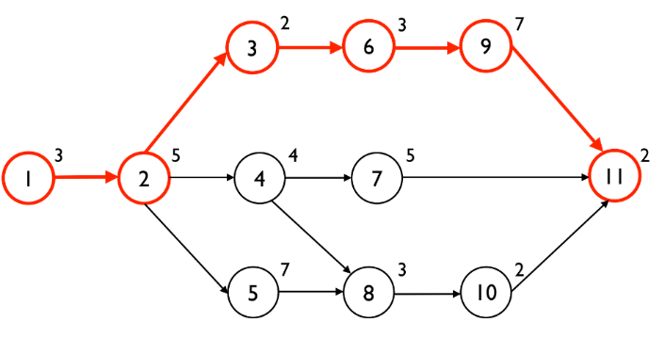
NETWORK ANALYSIS : PERT & CPM

Slide 2
Introduction
Network analysis is one of the important tools for project management.
Whether major or minor, a project has to be completed in a definite time & at a definite cost.
The necessary information of any particular data can be represented as a project network.
These techniques are very useful for planning, scheduling and executing large-time bound projects involving careful co-ordination of variety of complex and interrelated activities.

Slide 3
Objectives of network analysis
Helpful in planning
Inter-relationship of various activities
Cost control
Minimisation of maintenance time
Reduction of time
Control on idle resources
Avoiding delays, interruptions

Slide 4
Applications of network analysis
Planning, scheduling, monitoring and control of large and complex projects.
Construction of factories, highways, building, bridges, cinemas etc.
Helpful to army for its missile development.
Assembly line scheduling
Installation of computers and high tech machineries
To make marketing strategies

Slide 5
Methodology Involved in Network Analysis
Describing the Project
Diagramming the network
Estimating the time of completion
Deterministic
estimates
Probabilistic
estimates
Monitoring the project progress

Slide 6
Key Terminologies
Activity : All projects may be viewed as composed of activities. It is the smallest unit of work consuming both time& resources that project manager should schedule & control.
An activity is represented by an arrow in network diagram

Slide 7
Event
The beginning & end of an activities are called as events .
Events are represented by numbered circles called nodes.
Activity
i
j
Event start
Event finish

Slide 8
Types of Events
Merge event
Burst event
Merge & Burst Event

Slide 9
Classification of activities
Predecessor activity: Activities that must be completed immediately prior to the start of another activity are called predecessor activities.
Successor activity : activities that cannot be started until one or more of other activities are completed but immediately succeed them are called successor activities.
Concurrent activities: activities that can be accomplished together are known as concurrent activities.
Dummy activity: An activity which does not consume any resource but merely depicts the dependence of one activity on other is called dummy activity. It is introduced in a network when two or more parallel activities have the same start and finish nodes.

Slide 10
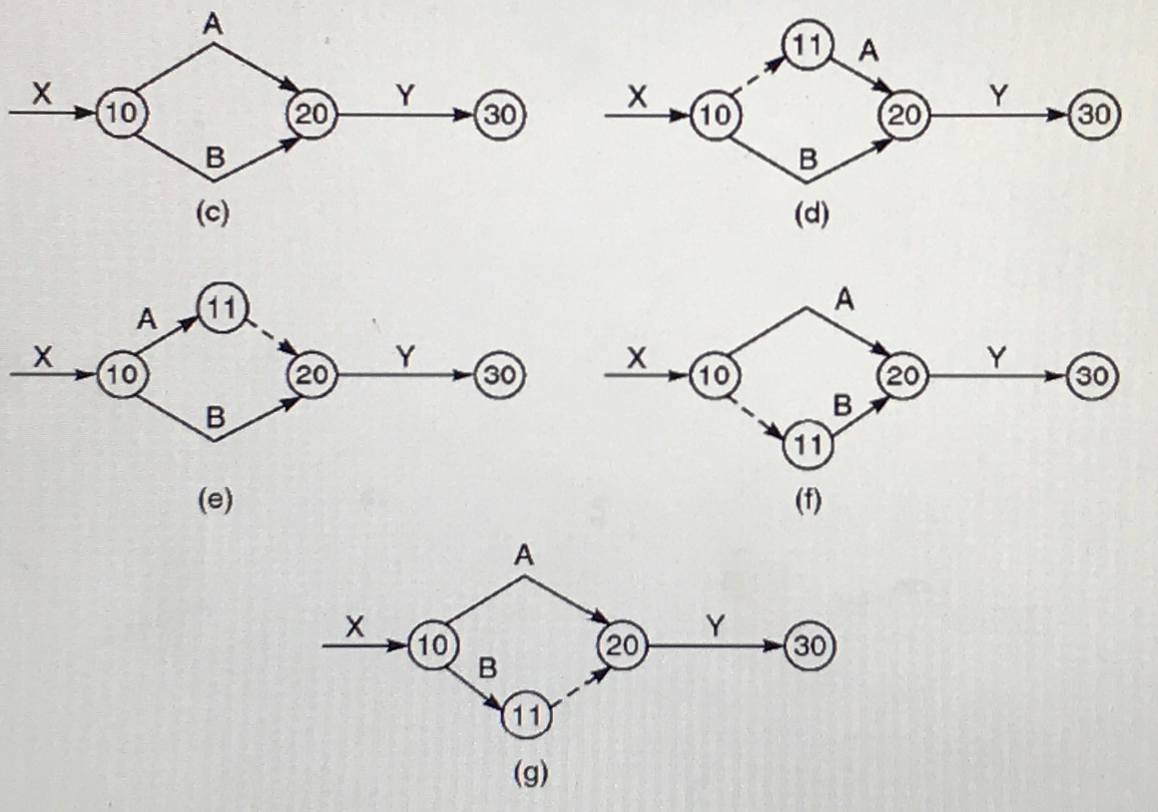

Slide 11
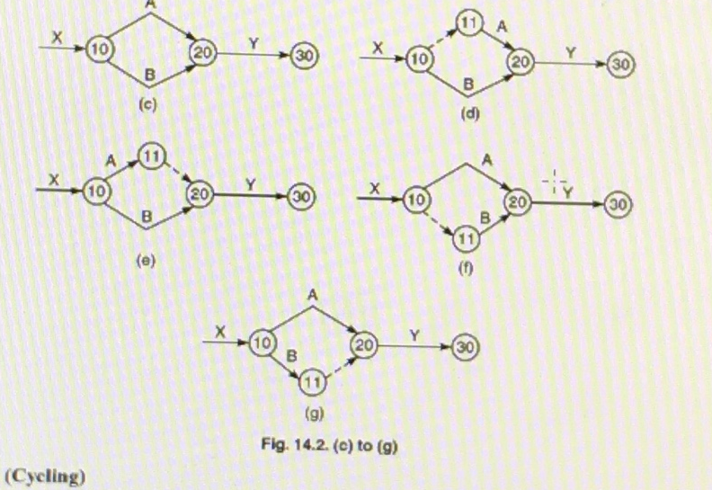

Slide 12
Path & Network
An unbroken chain of activity arrows connecting the initial event to some other event is called a path.
A network is the graphical representation of logically & sequentially connected arrows & nodes representing activities & events of a project . It is a diagram depicting precedence relationships between different activities.

Slide 13
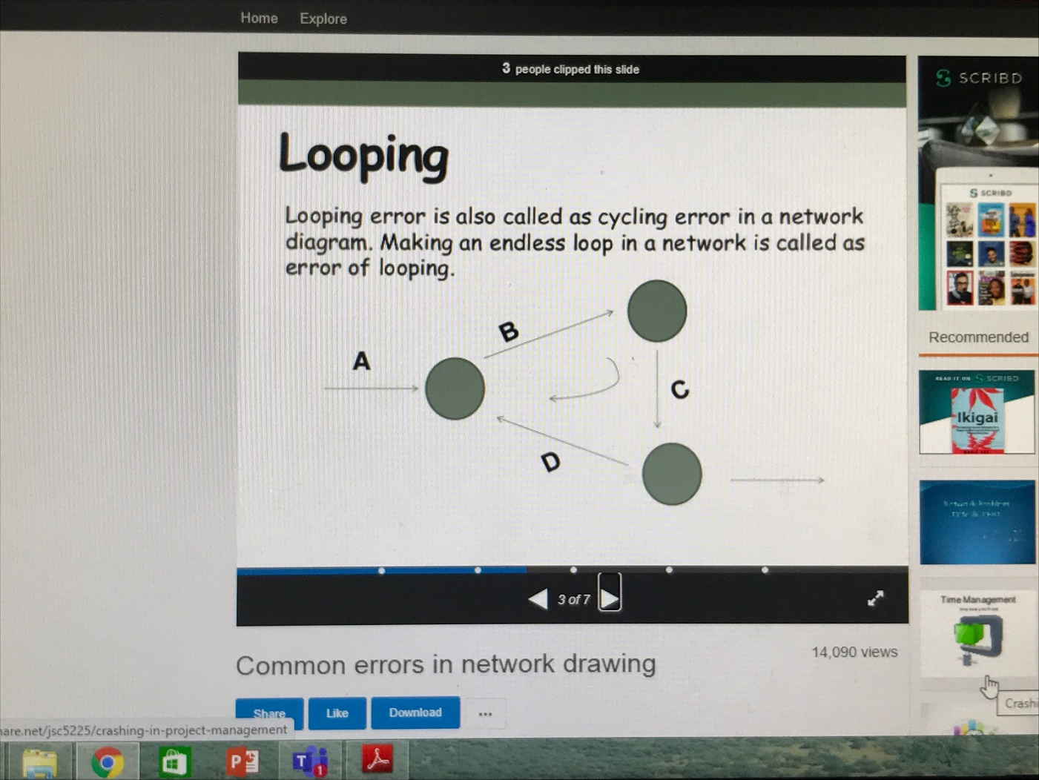
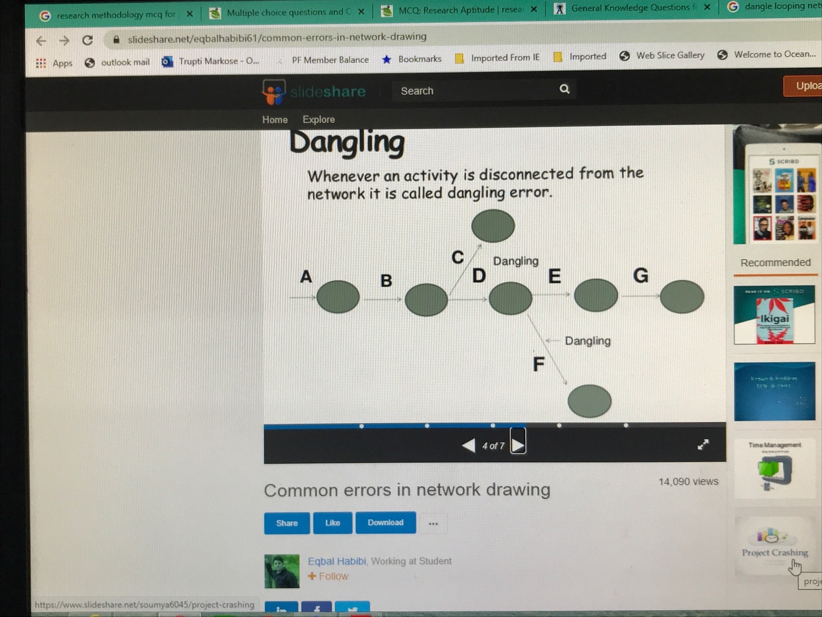
Errors in network logic
Looping : looping is known as cycling error and creates an impossible situation and it appears that none of the activities could ever be completed.
Dangling : sometimes a project network includes an activity which does not fit into the end objective of the project and is carried out without any result related with completion of the project . Such an error in network is called dangling

Slide 14
Guidelines for Network Construction
A complete network diagram should have one stand point & one finish point.
The flow of the diagram should be from left to right.
Arrows should not be crossed unless it is completely unavoidable.
Arrows should be kept straight & not curved or bent.
Angle between arrows should as large as possible.
Each activity must have a tail or head event.. No two or more activities may have same tail & head events.
Once the diagram is complete the nodes should be numbered from left to right. It should then be possible to address each activity uniquely by its tail & head event.

Slide 15
Advantages
Planning & controlling projects
Flexibility
Designation of responsibilities
Achievement of objective with least cost
Better managerial control

Slide 16
Limitations of PERT /CPM
Network diagrams should have clear starting & ending points , which are independent of each other which may not be possible in real life.
Another limitation is that it assumes that manager should focus on critical activities.
Resources will be available when needed for completion for an activity is again unreal.

Slide 17
Difficulties
Difficulty in securing realistic time estimates.
The planning & implementation of networks requires trained staff.
Developing clear logical network is troublesome.

Slide 18
Example
Activity | Predecessor activity
A | none
B | none
C | A
D | A
E | B
F | C
G | D & E
C
2
4
F
A
D
1
6
B
3
G
5
E

Slide 19
Draw the network diagram for the following
Activity | Predecessor activity
A | none
B | A
C | A
D | B
E | C
F | D ,E

Slide 20
3
D
B
A
F
5
6
1
2
C
4
E

Slide 21
Difference between PERT & CPM

Slide 22
Critical Path Method
Those activities which contribute directly to the overall duration of the project constitute critical activities, the critical activities form a chain running through the network which is called critical path.
Critical event : the slack of an event is the difference between the latest & earliest events time. The events with zero slack time are called as critical events.
Critical activities : The difference between latest start time & earliest start time of an activity will indicate amount of time by which the activity can be delayed without affecting the total project duration. The difference is usually called total float. Activities with 0 total float are called as critical activities

Slide 23
Critical path
The critical path is the longest path in the network from the starting event to ending event & defines the minimum time required to complete the project.
The critical path is denoted by darker or double lines.

Slide 25
For activity 1-2, E = 0 + 15 = 15
For event 6, L6 = L7 -14 = 54-14= 40

Slide 27
Float : There are many activities where the maximum time available to finish the activity is more than the time required to complete the activity. The difference between the two times is known as float available for the activity.
There are four types of float:
Total float : It is the spare time available when all preceding activities occur at earliest possible times & all succeeding activities occur at latest possible times.

Slide 28
Critical Path = 1-2-3-4-6-7= 54 weeks

Slide 29
Free float : It is the time available when all preceding activities occur at the earliest possible time & all succeeding activities also occur at the earliest possible times.
Free float = Total float - head event slack
Independent Float : It may be defined as the amount of time by which the start of an activity can be delayed without affecting the earliest start time of any successor activity , assuming that preceding activity has finished at its latest finish time.
Independent Float = free float – tail event slack
Interfering Float: It is that part of the total float which causes a reduction in the floats of the succeeding activities. it can be defined as the difference between the latest finish time of the activity under consideration and the earliest start time of the following activity, or zero, whichever is larger. i.e = (L - E) = TF-FF = head event slack
Interfering Float = Total Float – Free Float

Slide 30
Example 2

Slide 31
3

Slide 32
E
TLS
TEF
L

Slide 33
Example 3

Slide 35
Method 3: The various paths and their durations are calculated

Slide 36
PERT
PERT is designed for scheduling complex projects that involve many inter-related tasks. it improves planning process because:
It forms planner to define the projects various components activities.
It provides a basis for normal time estimates & yet allows for some measure of optimism or pessimism in estimating the completion dates.
It shows the effects of changes to overall plans they contemplated.
It provides built in means for ongoing evaluation of the plan.

Slide 37
ESTIMATING ACTIVITY TIMES
Optimistic time ( t₀ ) : is that time estimate of an activity when everything is assumed to go as per plan. In other words it is the estimate of minimum possible time which an activity takes in completion under ideal conditions.
Most likely time ( t_{m} ) : the time which the activity will take most frequently if repeated number of times.
Pessimistic time ( tp) : the unlikely but possible performance time if whatever could go wrong , goes wrong in series. In other words it is the longest time the activity can take.

Slide 38
EXPECTED TIME
The times are combined statically to develop the
expected time t_{e}
Standard deviation
Variance

Slide 39
STEPS INVOLVED IN PERT
Develop list of activities.
A rough network for PERT is drawn.
Events are numbered from left to right.
Time estimates for each activity are obtained.
Expected time for each activity is calculated : to+4tm+tp / 6
Using these expected times calculate earliest & latest finish & start times of activities.
Estimate the critical path.
Using this estimate compute the probability of meeting a specified completion date by using the standard normal equation
Z = Due date – expected date of completion
standard deviation of critical path

Slide 42
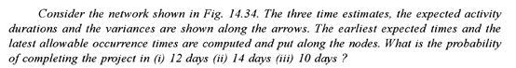
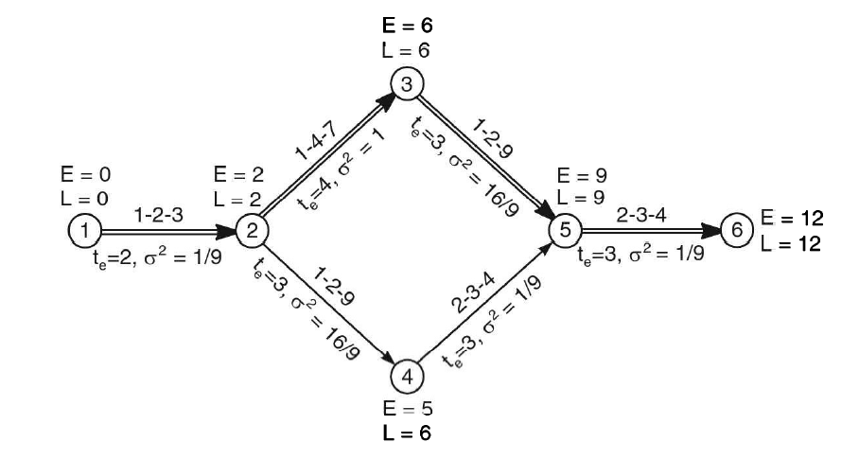

Slide 43
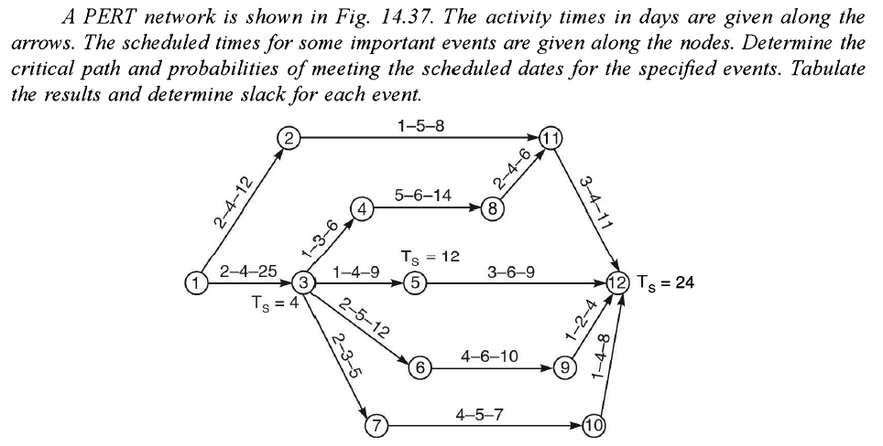

Slide 44
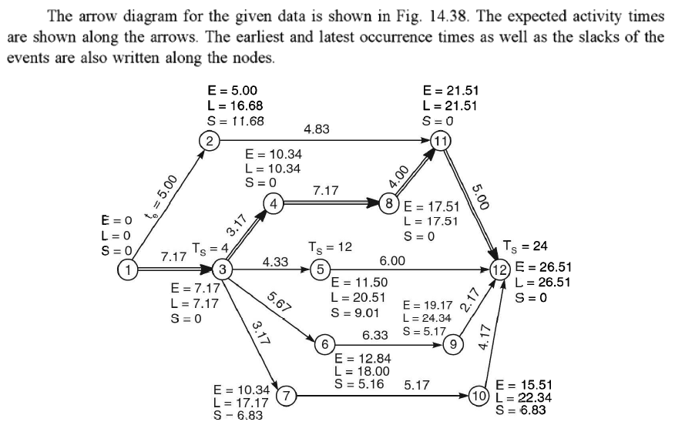

Slide 45
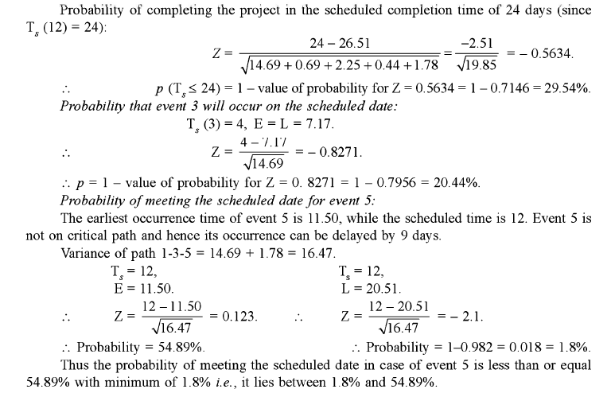

Slide 46
QUESTION : The table shows activities of project. Duration (days)
JOB | OPTIMISTIC | MOST LIKELY | PESSIMISTIC
1-2 1-3 2-4 2-6 3-4 3-5 4-5 5-6 | 1 5 3 1 10 2 5 2 | 4 10 3 4 15 4 5 5 | 7 15 3 7 26 6 5 8

Slide 47
Draw the network &find expected project completion time.
What is the probability that it would be completed in 41 days.

Slide 48
Variance of critical path
Activity | To | Tp | variance
1-3 3-4 4-5 5-6 | 5 10 5 2 | 15 26 5 8 | 2.77 7.11 0 1 Total= 10.88

Slide 49
So, standard deviation = 3.30
Probability for completing the job in 41 days.
Z = DUE DATE – EXPECTED DATE OF COMPLETION
S.D. OF CRITICAL PATH
= 41 – 36
3.30
= 1.51
The tabulated value of corresponding to calculated value i.e. 1.51 is .4345
So probability is .5 + .4345 = .9345 i.e. 93.45% that project will be completed on 41 day.

Slide 50
QUESTION: Activity predecessor time estimates (weeks)
activity | Preceding activity | to | tm | tp
A B C D E F G | - - A A B C D,E | 2 2 1 4 4 3 1 | 3 3 2 6 5 4 1 | 10 4 3 14 12 5 7

Slide 51
Find the expected duration and variance of each activity.
What is the expected project length?
Calculate the variance &standard deviation of the project length.

Slide 52
activity | to | Tm | tp | te | variance
A B C D E F G | 2 2 1 4 4 3 1 | 3 3 2 6 5 4 2 | 10 4 3 14 12 5 7 | 4 3 2 7 6 4 2 | 16/9 1/9 1/9 25/9 16/9 1/9 1

Slide 53
Various paths &expected project length
A-C-F = 4+2+4 = 10
A-D-G = 4+7+2 = 13 CRITICAL PATH
B-E-G = 3+6+2 = 11
Thus critical path is A-D-G with an expected length of 13 days. Hence the expected project length is 13 days.
Project variance = 16/9 + 25/9 + 1 = 50/9

Slide 54
